Slide 1
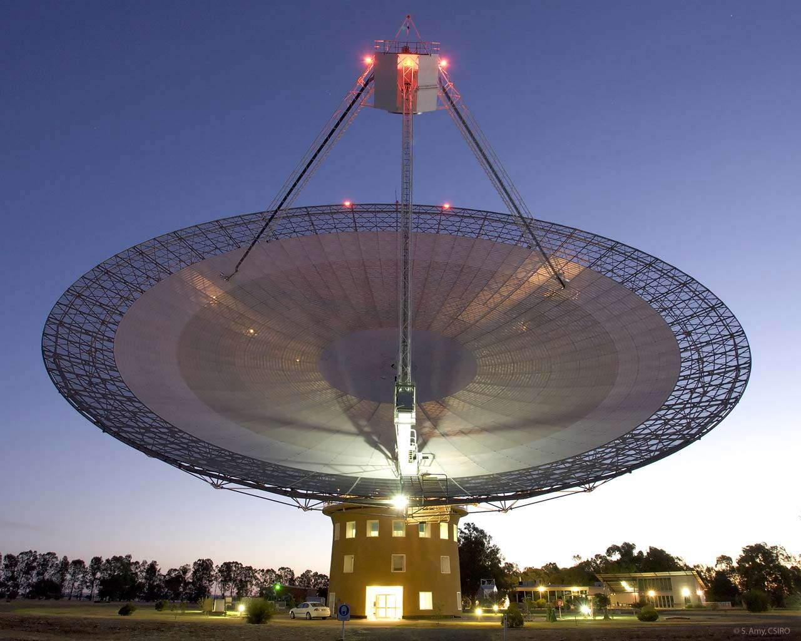
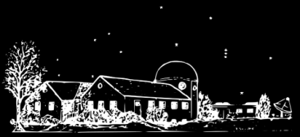
Justine Haupt, W2GFO
Demystifying
Radio Astronomy
CUSTER OBSERVATORY
Notes:
Being an optics person I see radio as an extension of optics, but having come to this from the outside I was a bit mystified about it and I know the subject is an absolute enigma to most people. Is it about listening to or watching the night sky? Is this something that an amateur could do, the way amateurs have optical telescopes? Why is the universe transmitting radio waves?

Slide 2
Outline
Radio & light
Antennas
Short history of radio astronomy
Science summary
Radio optics (yes)
Introduction to amateur radio astronomy
New frontier: Imaging with a homebrew radio telescope
Foundation
Radio Astronomy
Amateur
Radio Astronomy

Slide 3
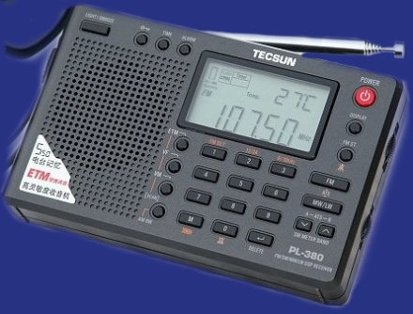
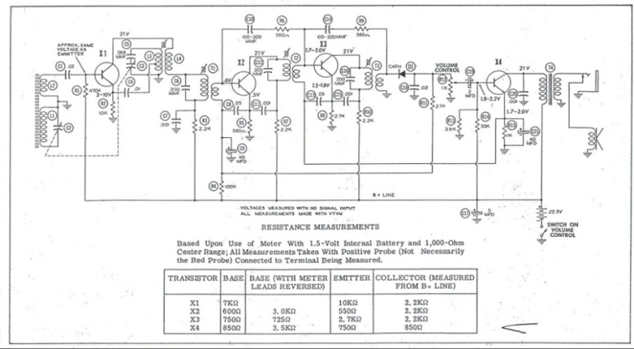
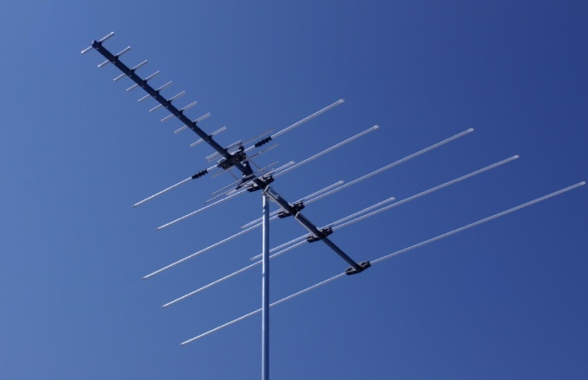
Radio & light
Antennas
Short history of radio astronomy
Science summary
Radio optics (yes)
Introduction to amateur radio astronomy
New frontier: Imaging with a homebrew radio telescope
Foundation
How does this work?
Radio Astronomy
Amateur
Radio Astronomy
Notes:
When you think about radio technology, what comes to mind? Things like radios, complicated electrical engineering, and antennas?
Segue: To shake the common conceptions about what radio is. Here are some terms which might seem nonsensical but which are perfectly valid.

Slide 4
Radio & light
Seemingly dissonant terms:
Radio internet
Radio television
Radio computers
Radio phones
Radio optics
Radio light
Notes:
What are these things?
Segue: The things we use all the time.

Slide 5
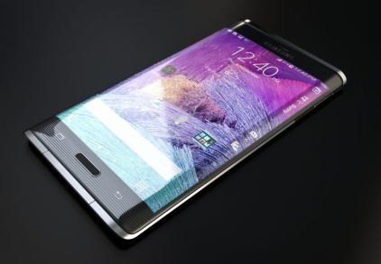
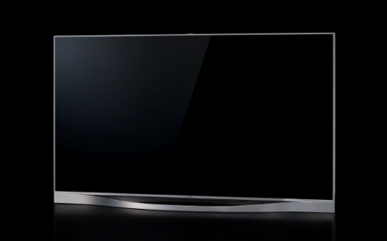
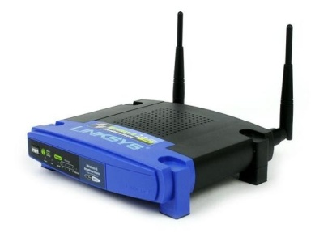
Radio & light
Seemingly dissonant terms:
Radio internet (Wifi, G3/G4)
Radio television (antenna TV, satellite TV)
Radio computers (Wifi, bluetooth, mice, keyboards, etc.)
Radio phones (cell phones, cordless phones)
Radio optics (antenna design, especially dishes)
Radio light (radio = redder than infrared)
Notes:
This list is meant to dislodge the idea that radio means a scratchy voice over a car radio.

Slide 6
Radio & light
Radio Technology
Notes:
Best thing to do when thinking about this is to forget everything we associate with the term radio and recall that all electromagnetic radiation is different kinds of light. The universe doesn’t know anything about how we’ve been able to manipulate the bands that we call “microwave” and “radio” for communications or transmitting data or music.
Segue: Not only this but the divisions between the gamma band, x-ray band, etc. are arbitrary.

Slide 7
Radio & light
Radio Technology
Arbitrary divisions
Notes:
This spectrum would have you believe there is a distinct, discreet difference between optical light and infrared, infrared and radio, but except for the physiological matter of our eyes, no such transitions exist.
I would go so far as to say that the bands of EM radiation that we can’t see can be thought of as other colors of light. It’s easy to accept that infrared light is light that’s such a deep shade of red that its invisible to us, but what if we keep going in that direction. At some wavelength of infrared light, we start calling it microwaves, but to me this is a range of exceptionally red light, much more so than infrared. And beyond that even, everything even redder we call radio. Conversely, one can think of visible light as super high frequency radio.
Segue: Our preconceptions (and eyes) aside, what you have is a completely smooth transition from the highest frequency naturally generated EM radiation to the lowest frequency radiation.

Slide 8
Radio & light
Notes:
As there are photons of green and blue light, there a are radio photons and x-ray photons.
Segue: It’s especially clear that the universe is blind to our ideas about EM radiation if you consider how its generated and how common it is. Hot objects glow, but the blackbody spectrum tells us that objects of all temperatures are glowing in some color of EM radiation.

Slide 9
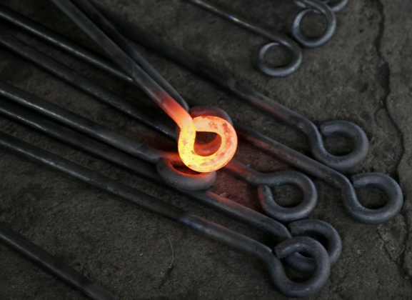
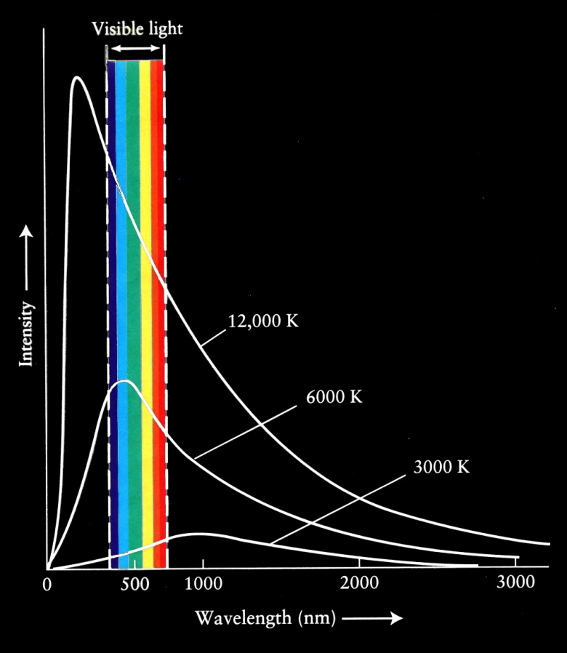
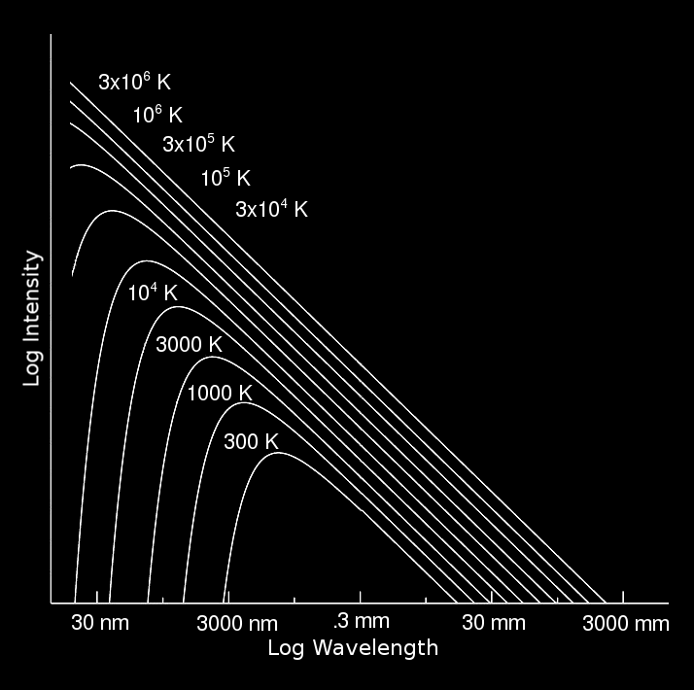
Radio & light
Notes:
The familiar blackbody spectrum is shown on the left where we see that by the time the temperature of some object has risen to 3000 K it’s emitting light that we can see, peaking somewhere around 1um wavelength and trailing off going further into the IR and into the visible. This is happening regardless of where the window of our eyes lie, and this creates a bias in us. We think that objects start to glow when they get very hot, but in reality all matter that has a temperature above absolute zero is glowing some color of EM radiation, regardless of how far outside our visual range it might be.
The plot on the right is also the blackbody spectrum but here intensity is on a log scale and the wavelength is extended out to 3m, which is 100MHz on your FM dial.
In this expanded view we can see that a person is glowing in the infrared down to 3um wavelength (100THz) and up all the way to ~10mm wavelength (30GHz), which touches one of the communications bands for satellites (Ka), and some of the hottest objects like Class-O stars are glowing out to ~1m wavelengths (300MHz).

Slide 10
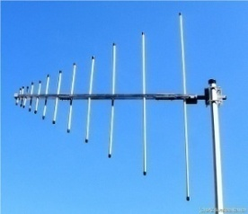
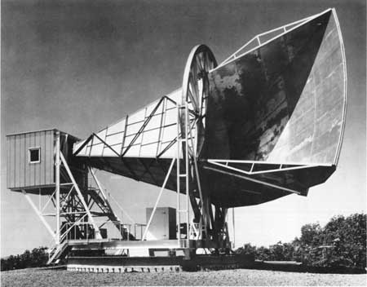
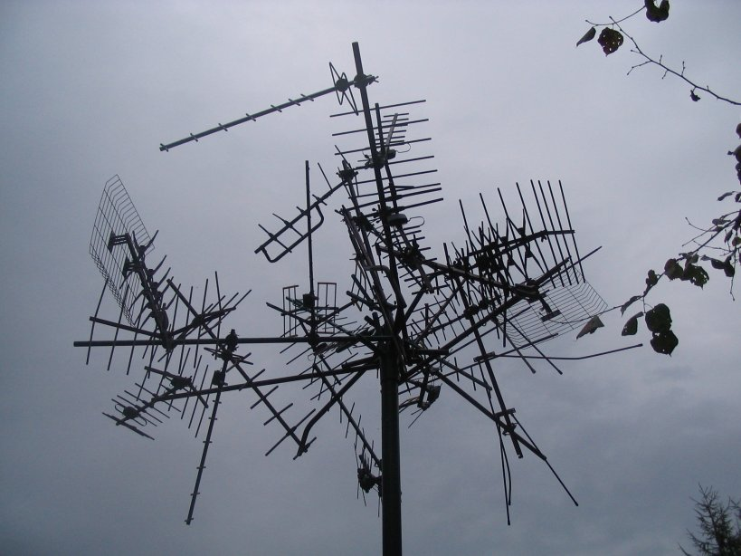
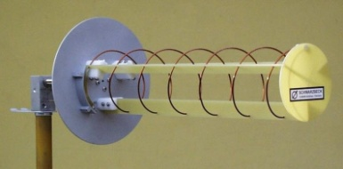
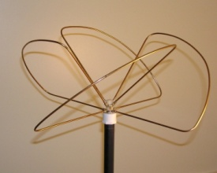
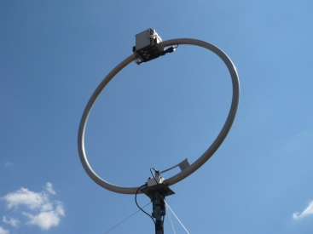
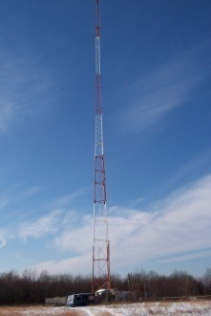
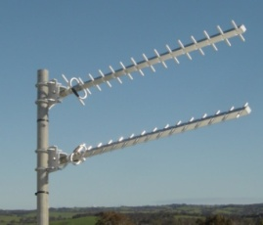
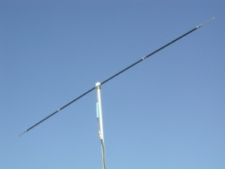
Radio & light
Antennas
Short history of radio astronomy
Science summary
Radio optics (yes)
Introduction to amateur radio astronomy
New frontier: Imaging with a homebrew radio telescope
Foundation
Radio Astronomy
Amateur
Radio Astronomy
Notes:
Radio is a color of light, light is very high frequency radio. To drive this home let’s look at antennas. Antennas are interesting things: they come in so many shapes and sizes and seem like magic.

Slide 11
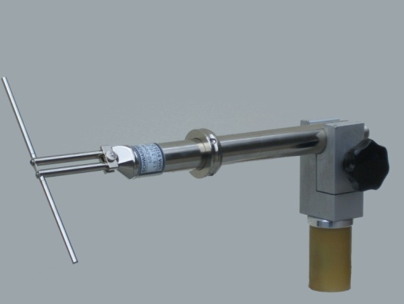
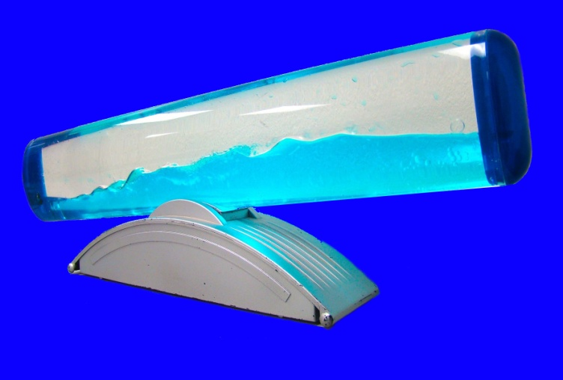
Antennas
λ
Antennas are electron “tanks” excited into oscillation by external perturbance:
λ/2
dipole antenna
Fundamental antenna form is the dipole: divided wire of certain length resonates with passing EM radiation
Notes:
An antenna is a resonator, and if the physical size of the antenna is conducive to resonance on a certain frequency, EM radiation impinging on it at that frequency will excite it producing a time-varying voltage at its output. The analogy of a container filled with water applies here.
Most antennas can be reduced to a basic form: the dipole, which is basically a wire with a gap in the middle. How to design a dipole antenna? It’s easy, the size of the dipole determines the frequency it’s sensitive to and generally is made to be half the length of the target wavelength.. .5MHz radio (AM broadcast) has a wavelength of 600m so your dipole would be 300m long, and 100MHz (FM broadcast) has a wavelength of 3m so your dipole would be 1.5m long. 2400MHz (wifi, microwave ovens, etc.) has a wavelength of 12.5cm, and so on. The algorithm for designing the antenna is therefore quite simple: it scales linearly with wavelength.
Segue: Essentially all other antennas are elaborations of this basic form, and any given antenna design, however compelx, can be made for any given frequency simply by scaling… the higher the frequency the smaller the antenna.

Slide 12
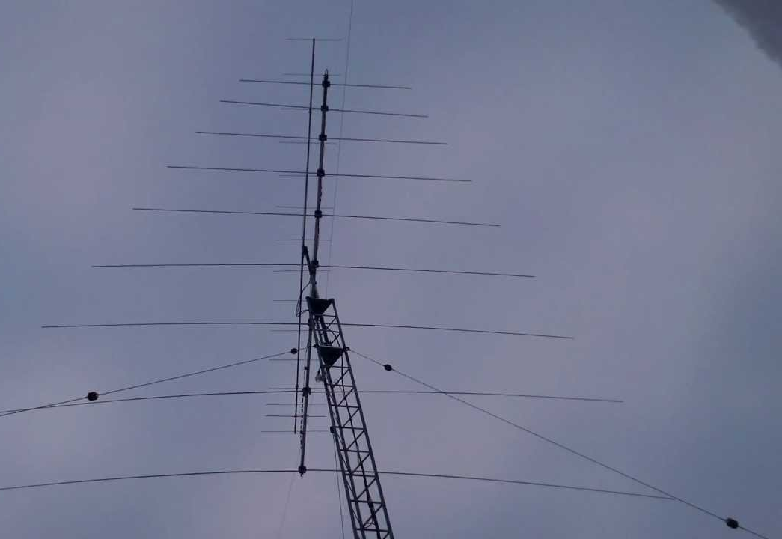
Antennas
λ
Sample case: Log Periodic Dipole Array (LPDA)
Array of dipoles decreasing in size (increasing in resonant frequency) toward the front
Same design, different frequencies:
40MHz
Notes:
The LPDA is a popular broadband antenna and a good example of scaled design.

Slide 13
Antennas
λ
Sample case: Log Periodic Dipole Array (LPDA)
Array of dipoles decreasing in size (increasing in resonant frequency) toward the front
Same design, different frequencies:
500MHz
40MHz
Notes:
The LPDA is a popular broadband antenna and a good example of scaled design.

Slide 14
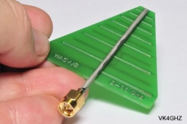
Antennas
λ
Sample case: Log Periodic Dipole Array (LPDA)
Array of dipoles decreasing in size (increasing in resonant frequency) toward the front
Same design, different frequencies:
2GHz
500MHz
40MHz
Notes:
The LPDA is a popular broadband antenna and a good example of scaled design.

Slide 15
Antennas
λ
How far can scaling go?
Could you make an antenna for visible light?
Same design, different frequencies:
2GHz
500MHz
40MHz
Notes:
So antennas scale. How far can that go? Will this 40MHz LPDA scale to 10GHz (3cm)? 100GHz (3mm?) What about optical frequencies?

Slide 16
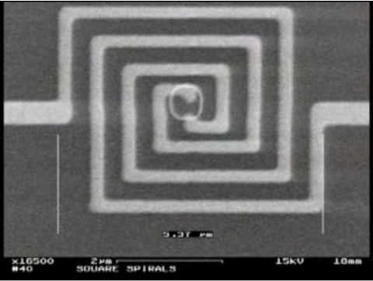
Antennas
λ
How far can scaling go?
Could you make an antenna for visible light? Yes.
Notes:
Yes. Nantennas are nano-scale antennas that are resonant near optical frequencies. Active area of research for solar power, although these need to rectify also.
By talking about antennas as devices that can in principle interact with all EM radiation, all the way from the lowest frequencies of radio light to visible light, I want to break down the preconception that these are fundamentally different things. Visible light is as much super high frequency (blue) radio as radio is super low frequency (red) light.

Slide 17
Radio & light
Antennas
Short history of radio astronomy
Science summary
Radio optics (yes)
Introduction to amateur radio astronomy
New frontier: Imaging with a homebrew radio telescope
Foundation
Radio Astronomy
Amateur
Radio Astronomy
Notes:
This is a good place to go back in time.

Slide 18
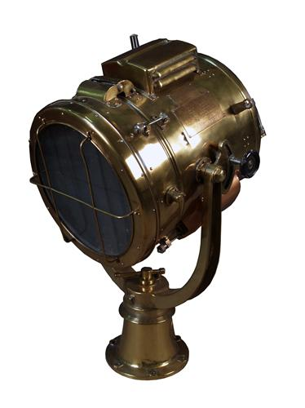
History of radio
1850s: M. Faraday proposes concept of electric fields
1873: Maxwell publishes theory. Makes powerful mathematical prediction that fields can propagate in open space and that light is an example of this effect. Math is cumbersome.
1884: O. Heaviside refines Maxwell’s theory.
1880s: D. Hughes & H. Hertz separately prove Maxwell by demonstrating in lab
Folks realize physical mechanism of “Hertzian Waves” could be used to communicate. Think of light signaling.
1890s: Simple signaling commercialized (Morse adopted from telegraphy)
1900s: First demonstrations of analog sound (e.g. voice) over radio, and first radio navigation systems created
1920: First broadcast radio stations start transmitting
Notes:
In 1873 James Maxwell formalized Faraday’s theory of electric fields and made the powerful mathematical prediction that these fields could propagate in open space, and that light is an example of this effect.
The math was refined significantly in 1884 by Oliver Heaviside (when we talk about “Maxwell’s Equations” we’re really talking about Heaviside's simplification Maxwell’s original theory). Also in the 1880s David Hughes and Heinrich Hertz (separately) proved Maxwell’s theory by demonstrating this propagation in the lab.
Folks realized this physical mechanism could be used for communications (like light signaling but with light that’s not limited to line of sight). Progress happens rapidly with voice transmission demonstrated around 1900 and navigation by radio starting a few years later.
Segue: Over the course of these ~50 years that humans were figuring out how to generate radio light and use it to do useful things, it probably wasn’t obvious that natural radio emission might be possible or even prolific.

Slide 19
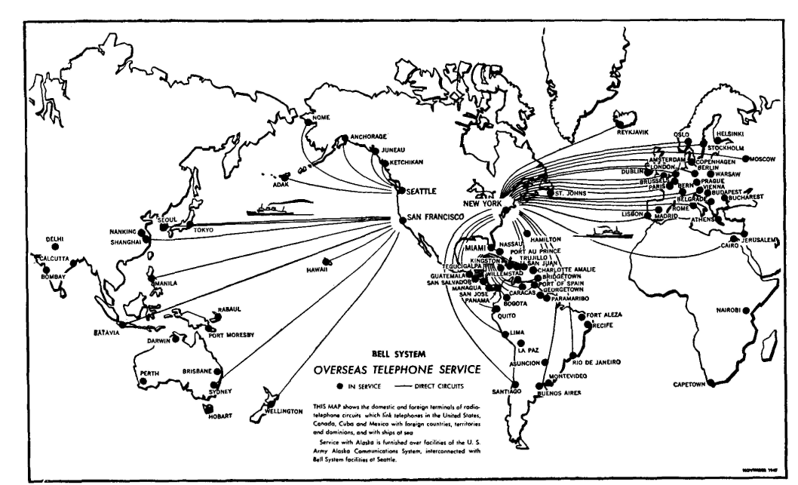
History of radio
1927: Bell’s transatlantic “radiotelephone” service goes online.
Notes:
The story starts to get interesting in the late 1930s with Bell’s new transatlantic radio telephone service. It went online in 1927 on 60KHz (a low frequency by today’s standards) and was upgraded to 10-20MHz in 1929 (present day shortwave).
The service was plagued by interference and static, and the person tasked with finding the source of the interference was a young scientist named Karl Jansky.
Segue: To locate the direction of the interference he built a directional rotating antenna that he could spin 360 degrees to monitor the varying degrees of static.

Slide 20
History of radio astronomy
1927: Bell’s transatlantic “radiotelephone” service goes online.
Notes:
The story starts in the late 1930s with Bell’s new transatlantic radio telephone service, which was the first of its kind. This service went online in 1927 on 60KHz (a low frequency by today’s standards) and was upgraded to 10-20MHz in 1929 (present day shortwave). The service was plagued by interference and static, and the person tasked with finding the source of the interference was a young scientist named Karl Jansky.
Segue: To locate the direction of the interference he built a directional rotating antenna that he could spin 360 degrees to monitor the varying degrees of static.

Slide 21
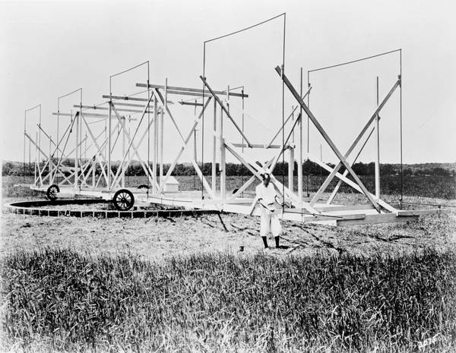
History of radio astronomy
1930: Karl Jansky’s 20.5 MHz rotating beam antenna starts looking for sources of communications interference and notices “a very steady hiss-type static”
Jansky’s “merry go round”
Notes:
In addition to indentifying thunder storms as a primary interference source by 1932 he could hear “a steady hiss-type static” which seemed to track in direction with a 24 hour cycle and in the following year he’d identified the hiss as being extraterrestrial in origin. He first thought the source might have been the sun but eventually realized the source was tracking with the sidereal rate, not the solar rate. He correctly surmised that the static was coming from the entire galaxy and particularly strong in the direction of the galactic core, in Sagittarius.
How does nature generate static at 20MHz? Not thermal radiation but synchrotron radiation and inverse Compton scattering.
In Jansky’s initial (now classic) paper on the subject “electrical disturbances apparently of extraterrestrial origin”, he thought his localization of the emission source might have been in error by as much as +/-30 degrees.

Slide 22
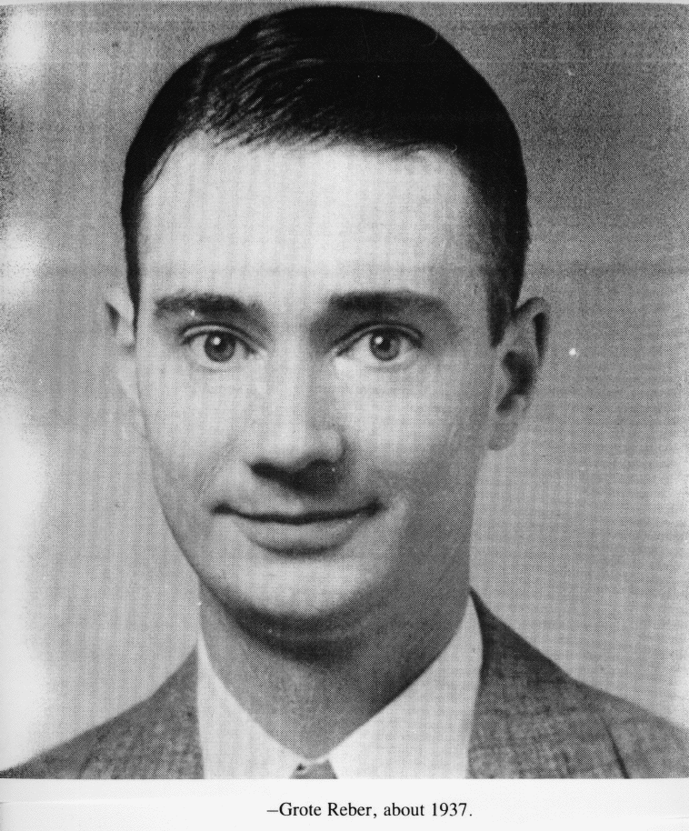
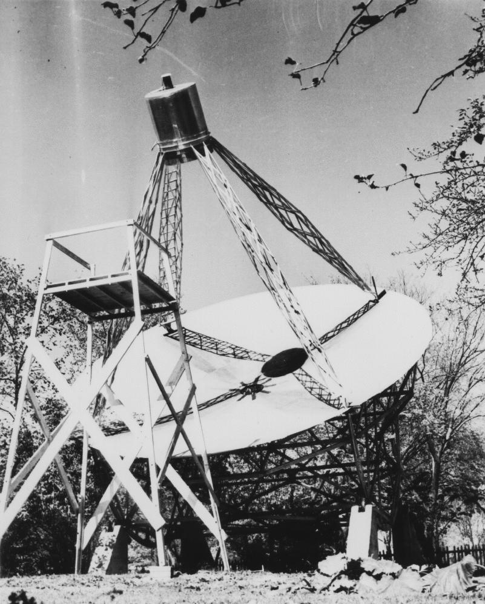
History
History of radio astronomy
Having identified the noise source, Bell work was complete
Took years for scientific interest to develop
1935-1941: Grote Reber (W9GFZ), electrical engineer and radio amateur built (at home) first dedicated, steerable dish antenna for radio astronomy and made first radio sky survey.
Negative results at 3.3GHz and 900MHz
Success at 160MHz, first sky map made
Notes:
Jansky had to go on to other things, and partly because Jansky had published in a relatively obscure radio technology journal it took a while for word about his discovery to spread. Also, traditional astronomy wasn’t really hospitable to the idea of radio sources in space. Optical astronomy is the oldest science and astronomers of the day weren’t interested in these newfangled electrical signals.
The next person to take serious interest wasn’t an astronomer but another radio engineer (and HAM), Grote Reber. In every historical account, the steerable dish antenna he built in his own backyard in his free time is considered to be the first real radio telescope, which he used to take Jansky’s initial observation to the next level and make the first crude radio map of the sky. Knowing only blackbody radiation as a possible radio generation mechanism he started searching at higher frequencies and made his way down to 160MHz. Positive detection at such a low frequency was perplexing and part of the reason the astronomical community was disinterested. Another part of the reason is that the earliest radio astronomers weren’t formally trained as astronomers; they were experts in radio technology that were curious about Jasnky’s discovery and they were learning astronomy as they went. They weren’t part of the astronomers’ “club”.
Segue: This quote by Reber underscores the disconnect between the new radio astronomy and traditional astronomy.

Slide 23
History
History of radio astronomy
Having identified the noise source, Bell work was complete
Took years for scientific interest to develop
1935-1941: Grote Reber (W9GFZ), electrical engineer and radio amateur built (at home) first dedicated, steerable dish antenna for radio astronomy and made first radio sky survey.
Negative results at 3.3GHz and 900MHz
Success at 160MHz, first sky map made
Reber:
“…[astronomers] could not dream up any rational way by which the radio waves could be generated, and since they didn’t know of a process, the whole affair was (considered by them) at best a mistake and at worst a hoax.”
Notes:
At the time it wasn’t known that there are ways to generate light without blackbody radiation, and anyway the people making these discoveries didn’t have the credibility of astronomers.
The science stagnated at this point.

Slide 24
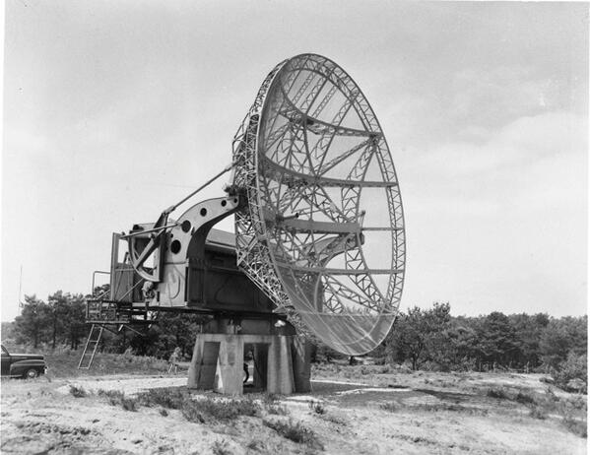
History of radio astronomy
Post WWII, excellent new radio telescopes readily available (surplus war radars)
Many radio astronomy programs begin in earnest and the science grows
OBJECTIVE OF POST WAR
RADIO ASTRONOMERS:
Make more accurate radio sky maps to isolate locations of radio sources
Brightest radio sources isolated to a handful of constellations:
Cassiopeia, Cygnus, Taurus, Sagittarius, among others
Observations become possible at higher frequencies with better equipment
Notes:
Through World War II there weren’t any noteworthy developments in the science, but while Jansky’s and Reber’s discoveries were settling in significant radar technology development was happening as part of the war effort. This was important because it was exactly the kind of technology that could be repurposed for doing radio astronomy.
After the war, substantial radio astronomy programs sprung up around the world using war surplus radar equipment, especially in North America and England.
The big drive for this initial radio observation effort was to isolate the sources of radio emission. Bright sources were found in a handful of constellations but resolution was still quite limited.

Slide 25
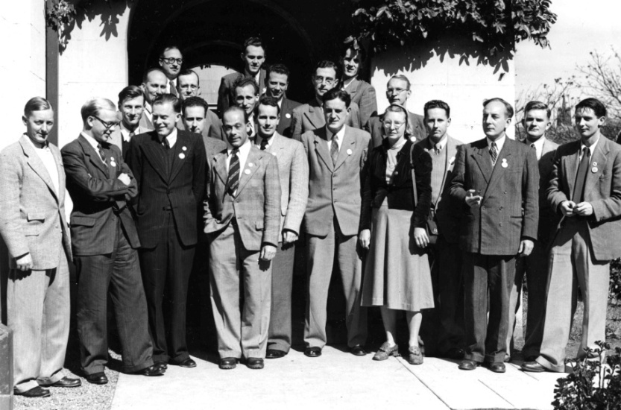
History of radio astronomy
By 1950s:
Several radio sources optically identified but frustrating lack of optical candidates for others.
Sources that are ID’d are confusing. E.g. Dim nearby galaxies and bright distant ones.
Separate naming convention for radio objects based on constellation.
Radio astronomy discoveries still suspicious to traditional astronomers.
From Gerrit L. Verschuur:
...radio astronomers were greatly impressed by the almost total lack of connection between radio observations and the visual sky. It did not seem impossible then that there were two separate kinds of celestial objects, each requiring distinct research techniques.
Notes:
If you’re a radio astronomer in the late 40s and 50s your goal is to find the known visible-light objects that are emitting radio, because you don’t expect there would be a visible-light sky and an entirely separate radio sky, although this was conceivable. It would be satisfying for example, if for every radio source you could find a nebula with a certain characteristic, or a particularly curious looking galaxy, but there seemed to be little correlation between the known visible sky and the newly emerging radio sky.
This drove the need to pinpoint the radio sources with increasing precision. And because radio sources weren’t instantly associated with obvious pre-existing optical objects they were named separately for the constellations they were in (Cas. A, Cyg. A). This separate naming convention stuck even after optical counterparts were identified and persist to this day.
Several unambiguous optical counterparts were identified around this period but they were confusing. Some of the brightest radio sources turned out to be some of the most distant galaxies (e.g. M87) and some of the very closest galaxies were faint radio sources (e.g. Andromeda).

Slide 26
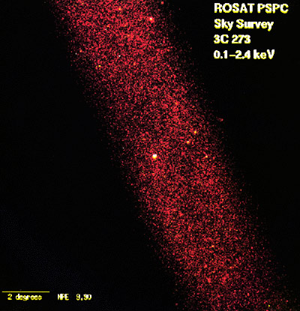
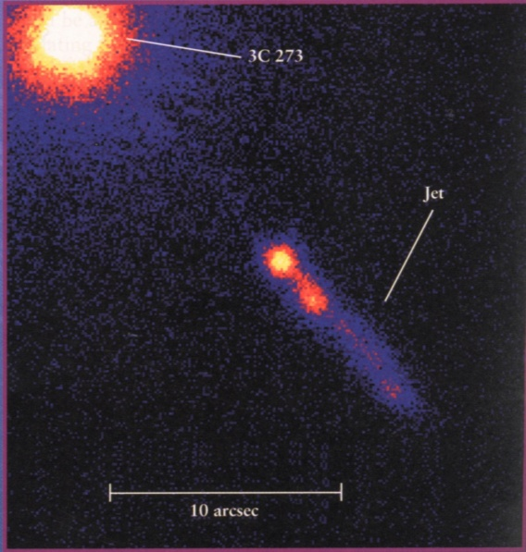
History of radio astronomy
Entering 1960s:
Scenario clarifies as discovery of optical counterparts becomes common
Understanding of observations improve as theories for physical mechanisms evolve
1962: Quasars discovered (type of AGN, also radio galaxy)
New discoveries force attention of astronomical community and radio astronomers finally indoctrinated

Slide 27
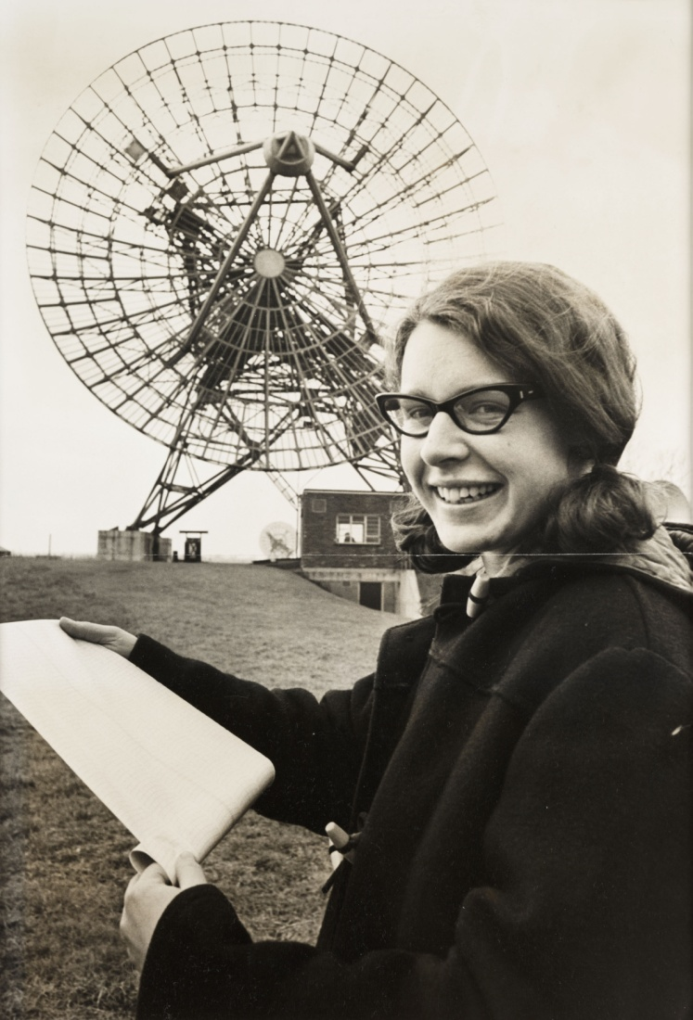
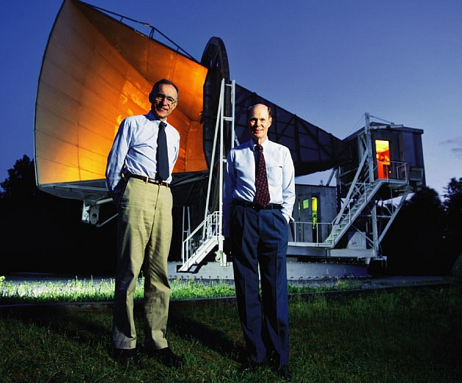
History of radio astronomy
1964: Arno Penzias and Robert Wilson discover CMB
1967: Jocelyn Bell discovers first pulsar
Penzias & Wilson
Jocelyn Bell

Slide 28
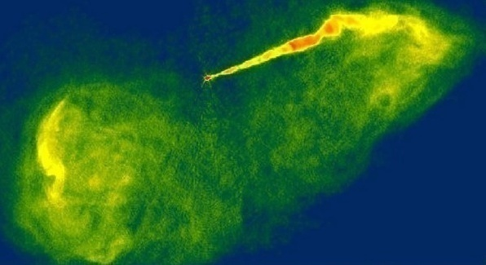
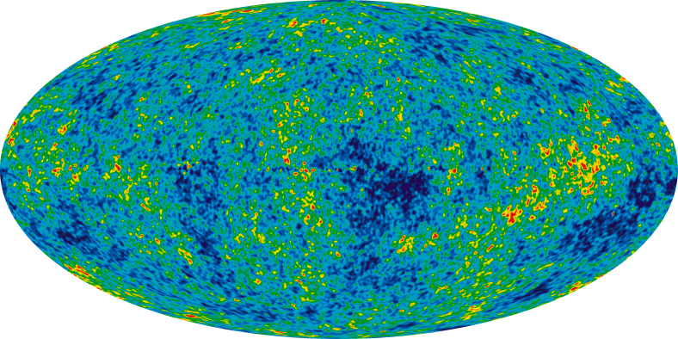
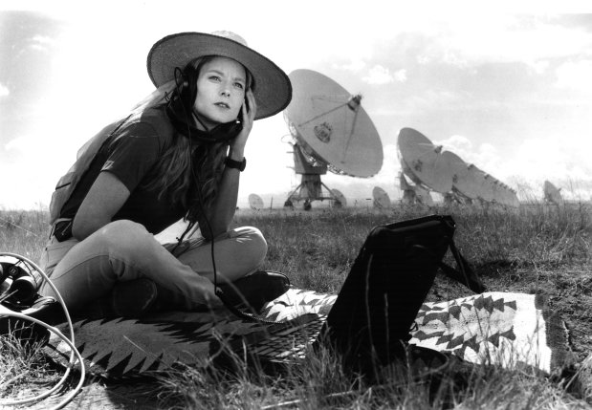
History of radio astronomy
1970s to present:
Leaps in receiver technology and high resolution imaging methods
Galactic jets observed
Theories of pulsars and quasars refined
Satellites observe CMB, big bang cosmology refined
Increasingly high frequency observations (millimeter and sub millimeter now bridging observation gap almost all the way to the IR)
SETI
2010: new kind of radio source discovered (Fast Radio burst)

Slide 29
Radio & light
Antennas
Short history of radio astronomy
Science summary
Radio optics (yes)
Introduction to amateur radio astronomy
New frontier: Imaging with a homebrew radio telescope
Foundation
Radio Astronomy
Amateur
Radio Astronomy
Notes:
What has radio astronomy taught us to date?

Slide 30
Science summary
Celestial objects that emit visible light generally also emit radio but intensity varies significantly
Emissions >300MHz tends to be thermal (black body), <300MHz tend to be non-thermal (Synchrotron, inverse Compton, or maser)
Terms “radio galaxies” and “radio stars” refer to galaxies and stars that are also exceptionally bright radio sources
Radio galaxies often have Active Galactic Nuclei: e.g. jets and quasars
Pulsars are a kind of radio star
Interstellar gas emits radio via non-thermal processes
Jupiter is an unusual, very bright non-thermal radio source.
Some radio-specific identifiers have more common names, e.g. Taurus A is the Crab Nebula
First light in universe (from after big bang) is still visible: 3000K blackbody radiation (mostly visible light) from when universe first became transparent. Redshift from expanding space (not velocity) makes this light appear as 160GHz radio (cosmic microwave background). Equivalent blackbody temp ~2.7K.

Slide 31
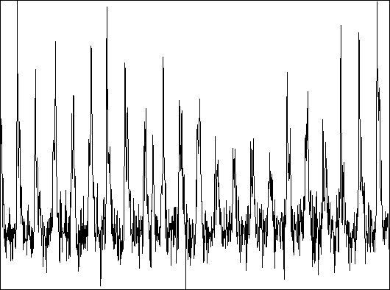
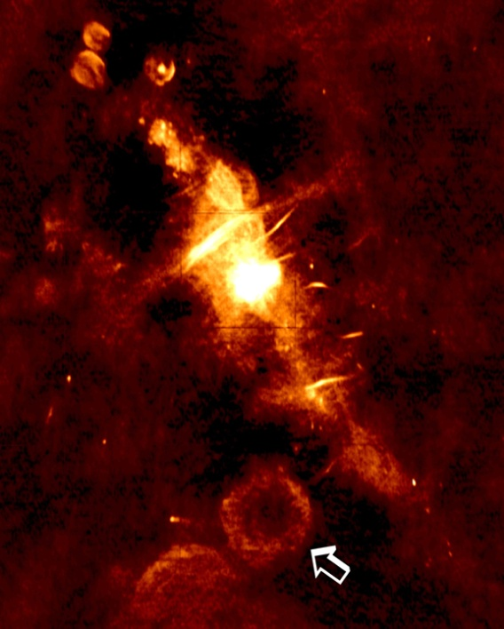
Radio observation modes
Time domain RF intensity (audio):
Pulsar identification, timing
Spectroscopy
SETI
et cetera
Single-dish observations typical
Imaging:
Same reasons as optical astronomy
Multi-dish observations typical
Notes:
A good time to summarize what it means to do radio astronomy. What is radio observation? If you’re sitting at a radio telescope what do you do to it?
Is it always about imaging? Is it always about listening? The answer is that it’s about sensing the natural radio emissions of the universe, sometimes by composing an image and sometimes by looking at acoustic-like patterns in the emission. Misleading to think of this in terms of listening because there isn’t any intentional audio modulation to natural signals; it’s varying degrees of noise.
There are two broad classes of radio astronomy observation: What one might think of as listening and what one might think of as imaging.
By listening I mean tracking the intensity of the radio signal point in the sky over time. This include measuring the periodically varying emissions of pulsars, spectroscopy, and SETI. For any of these things single-dish observations are typical.
The other observing category is imaging, and you do this for the same reasons you do imaging in optical astronomy. Mapping intensity variations of an object, whether it’s glowing in optical or radio bands, is good because it tells you a lot about the dynamics of the object as a physical system.
Segue: More than anything else about this subject, radio imaging seems to be mysterious. I’m going spend most of the remaining time talking about that, and this leads us right into the topic of radio optics.

Slide 32
Radio & light
Antennas
Short history of radio astronomy
Science summary
Radio optics (yes)
Introduction to amateur radio astronomy
New frontier: Imaging with a homebrew radio telescope
Foundation
Radio Astronomy
Amateur
Radio Astronomy
Notes:
Because if we’re talking about imaging using radio light, in effect we’re talking about optical science.

Slide 33
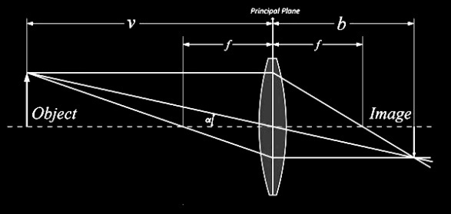
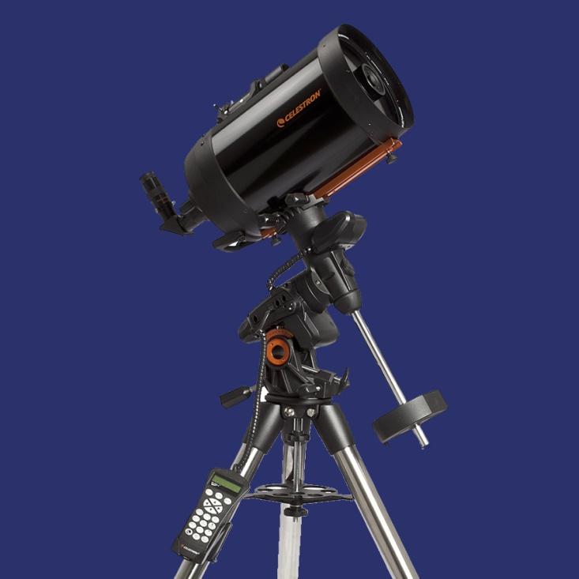
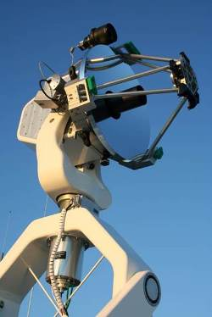
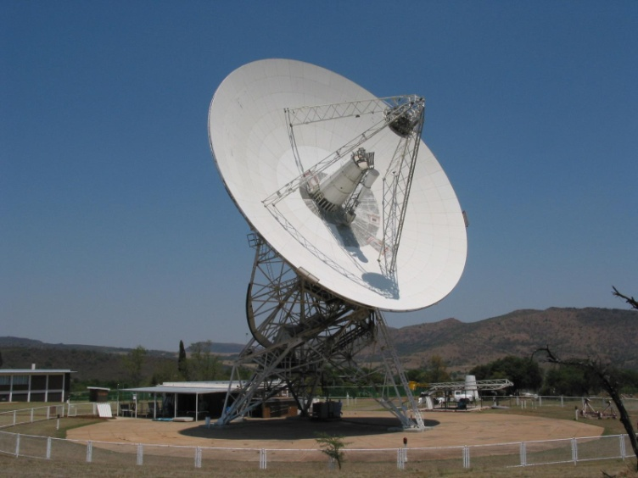
Radio optics
Both radio and visible light focused with lenses or mirrors
Lenses impractical for radio
Same optical formulae apply: image height = f tan(θ)
Mirror (dish) obvious choice
Most radio telescopes are prime focus or Cassegrain types
IMAGE
Cassegrain telescope morphogenesis:
OPTICAL
RADIO
Notes:
Both radio light and visible light are governed by the same optics. The thin lens equation, Snell’s law, diffraction calculations, and the mirror equations all apply.
But with radio, mirrors are used exclusively because it’s impractical to make lenses that work at radio wavelengths: Instead of glass we would be using materials like cement. In the language of optical telescopes, a radio dish is a reflecting telescope.

Slide 34
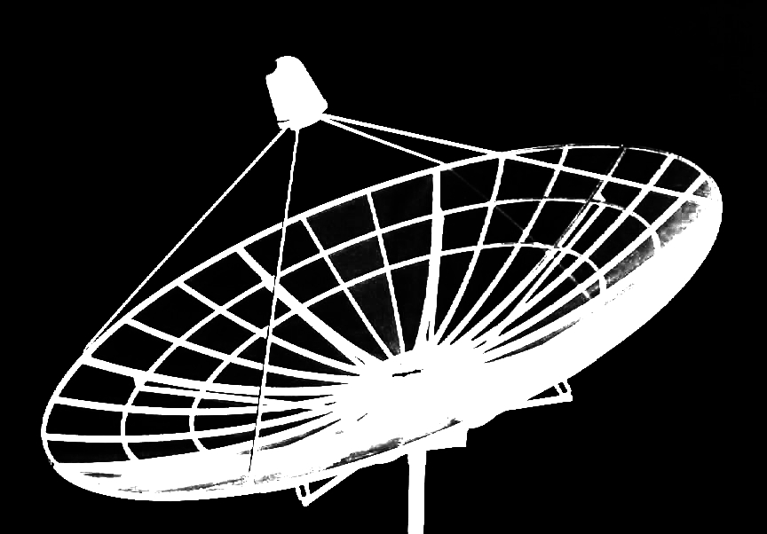
Radio optics
Dish antenna focusing radio light:
Image formed
Notes:
Any dish like this will focus a radio or optical image according to geometric optics, where the height of the image is equal to the reflector’s focal length times the tangent of the angle in the sky that it subtends.
Segue: Is a dish like this detecting an image?

Slide 35
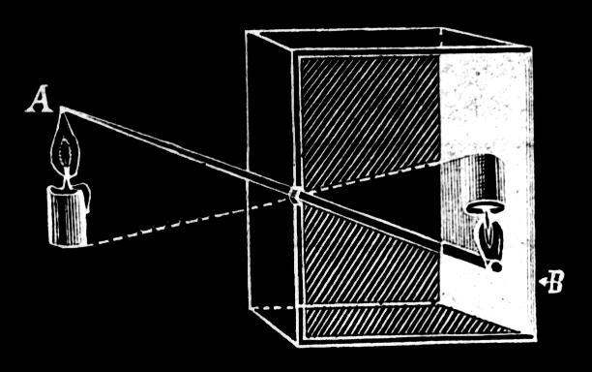
Radio optics
Dish antenna focusing radio light:
Image not detected by single-pixel detector
Notes:
No, because the dish’s antenna (sensor) is only a single pixel. This is no different than taking a camera and putting a photodiode in it instead of film.

Slide 36
Radio optics
Dish antenna focusing radio light:
Image not detected by single-pixel detector
Also:
Dish’s image resolving potential limited by diffraction
λ/d
Notes:
Additional complication:
In a camera or a dish antenna, whether a resolved image is actually formed depends on diffraction.
For a perfectly formed reflecting dish the concentration of the dish’s beam on the sky (in radians) is equal the wavelength observed divided by the diameter of the dish.
Example: For the 21cm neutral hydrogen emission line a 3m dish will have a beamwidth of .07 radians (4 deg.). For green light, the same dish will have a beam width of 9.5 micro degrees.

Slide 37
Radio optics
Anatomy of a dish antenna:
Feed (antenna): Located at focal point. Often a feed horn but any antenna type is possible. On consumer satellite dishes usually called an LNB.
Dish / reflector / mirror: Usually parabolic. Made from any radio reflective material (metalized plastic, wire mesh, solid metal, wire mesh in fiberglass). Weave size must be << wavelength.

Slide 38
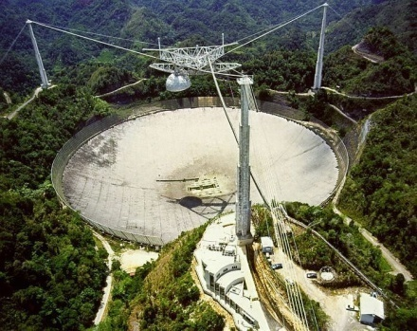
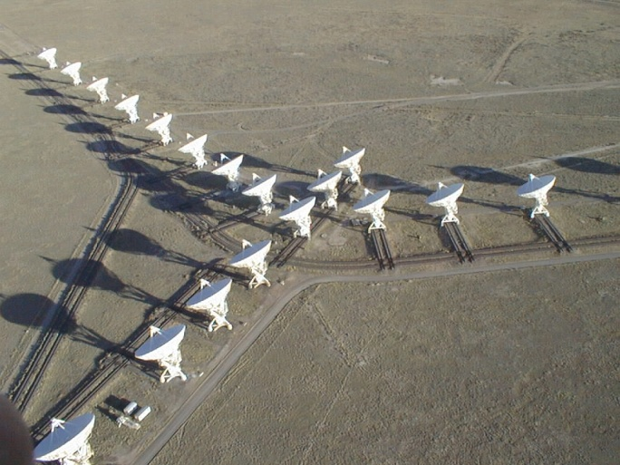
Radio Imaging
Single dish, single detector
Single dish, multiple detectors
Multi dish (interferometry)
Radar astronomy
Will Gloss Over
Notes:
How to make an image?

Slide 39
Radio Imaging
Single dish, single detector
Single dish, multiple detectors
Multi dish (interferometry)
Radar astronomy
Notes:
Can be done with a single dish with a single feed (detector) as shown on the previous slide.

Slide 40
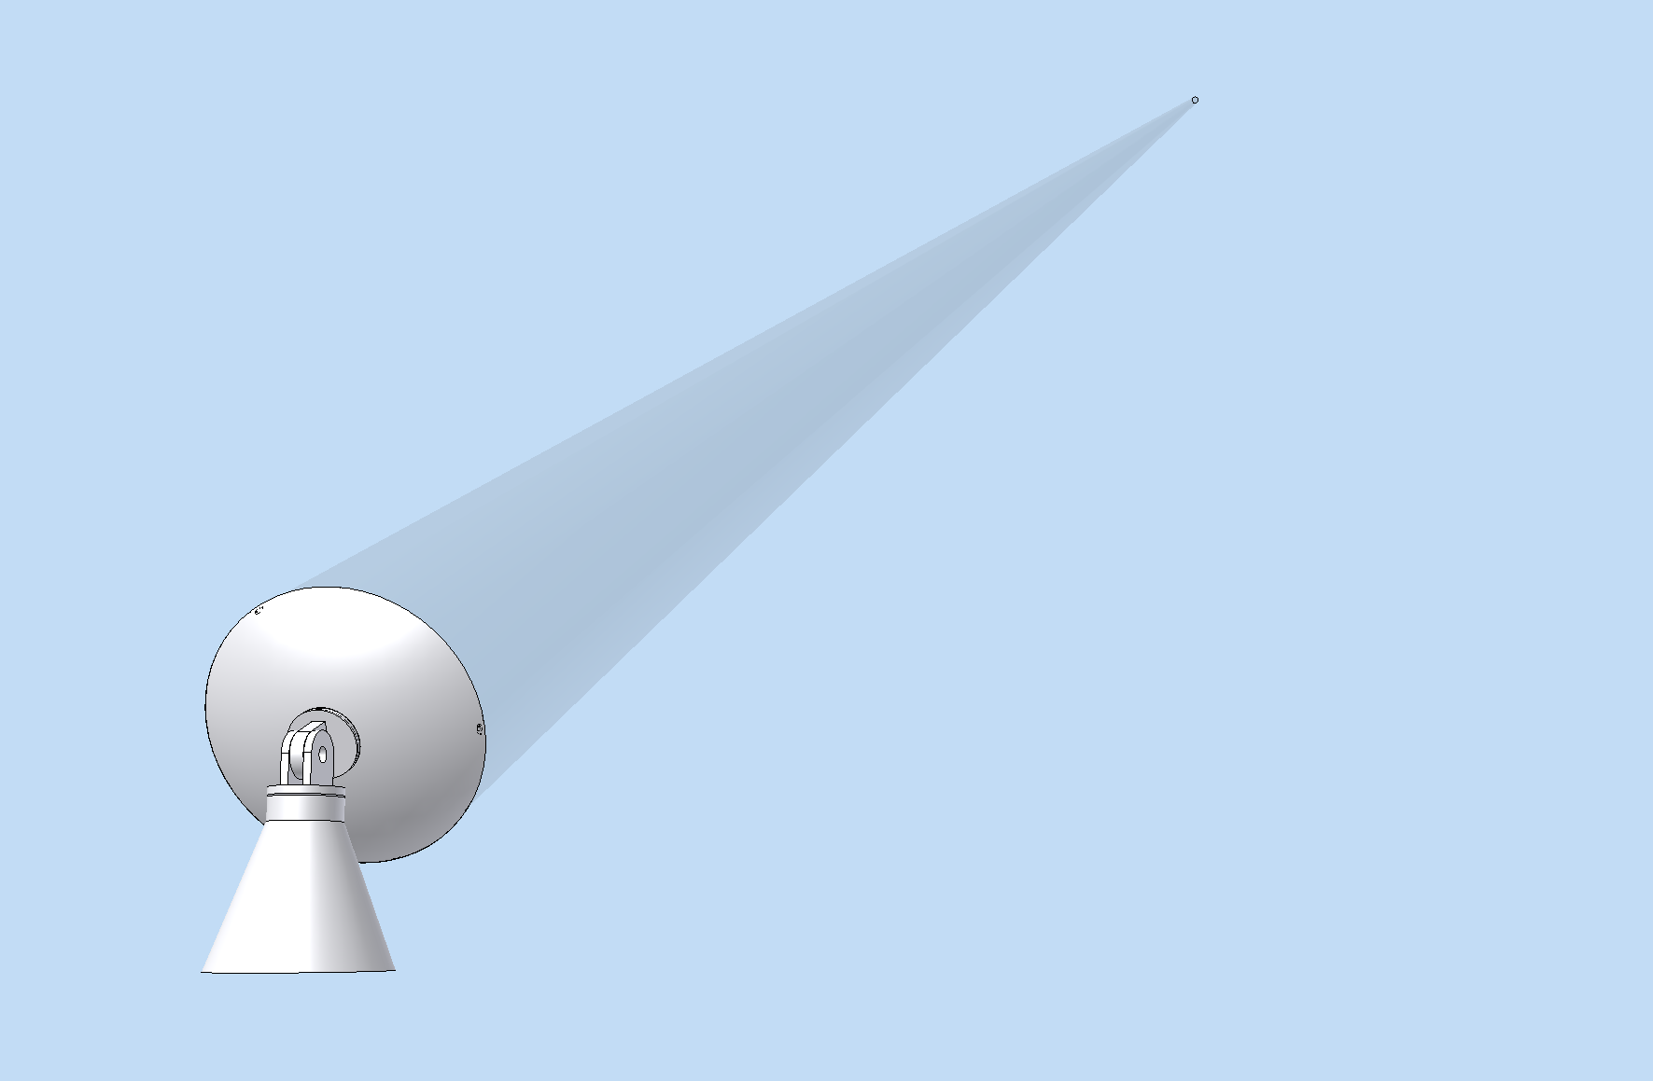
Drift scanning
Celestial objects drift past beam, power recorded
power
0 1 2 3 4
time
Notes:
Point your dish antenna at the sky and let celestial objects drift into and out of its beam of sensitivity with the earth’s rotation. If you record the intensity of the radio signal while doing this you’ll create a drift scan.

Slide 41
Drift scanning
Celestial objects drift past beam, power recorded
power
0 1 2 3 4
time

Slide 42
Drift scanning
Celestial objects drift past beam, power recorded
power
0 1 2 3 4
time

Slide 43
Drift scanning
Celestial objects drift past beam, power recorded
power
0 1 2 3 4
time

Slide 44
Drift scanning
Celestial objects drift past beam, power recorded
power
0 1 2 3 4
time

Slide 45
Drift scanning
Celestial objects drift past beam, power recorded
power
0 1 2 3 4
time
Notes:
Segue: Having recorded RF power as a function of some strip of the sky, what we’ve really done is to create a 1-D image, and we would be entirely justified to assign pixels to the plot.

Slide 46
Drift scanning
1D image
power
0 1 2 3 4
(position)
Notes:
This how radio astronomers took observations for a long time, but not having computers or any graphical processing capabilities they used strip chart recorders.
Segue: This is exactly how Jansky took the 1930 observations that launched the science.

Slide 47
Drift scanning
Jansky’s drift scan data:
Notes:
Jansky’s antenna spun around so he didn’t need to wait for the earth’s rotation, but the result is the same. This is one of his actual strip charts where we can see the variation in radio intensity with direction.

Slide 48
Drift scanning
Jansky’s drift scan data:
Notes:
Segue: A few years later Grote Reber also did drift scans.

Slide 49
Drift scanning
Grote Reber’s drift scan strip chart:
Notes:
Segue: Remember, he built the first dish radio telescope and this didn’t spin in complete circles like Jansky’s did.

Slide 50
Drift scanning
Grote Reber’s drift scan strip chart:
Notes:
He built it for control of the altitude axis only and relied on earth’s rotation for the other axis, so you can imagine a small patch of sky drifting by the dish over the course of hours with some radio galaxy making a peak, and another object going by making another peak.
Amateur radio astronomers are making these strip charts to this day with strip chart software.
Segue: Reber was making these strip charts and mapping the night sky in doing so. How do you make a 2D image? By taking a bunch of drift scans side by side.

Slide 51
Single dish imaging
Side by side drift scans
“2D strip chart”
Scan sky with dish, writing radio power to pixels

Slide 52
Single dish imaging
Grote Reber’s drift scan strip charts:

Slide 53
Single dish imaging
Reber’s radio maps:
Effectively a hand-drawn image. Isolines indicate equal intensity regions extracted from strip charts. Easy to replace with pixels with a computer for more conventional image.

Slide 54
Single dish imaging
Faster to actively scan sky with 2-axis mount (not relying on earth rotation)
Forego strip chart generation and write RF power variation directly to image matrix

Slide 55
Single dish imaging

Slide 56
Radio Imaging
Single dish, single detector
Single dish, multiple detectors
Multi dish (interferometry)
Radar astronomy

Slide 57
Single dish with multiple detectors
Pixelized feed
Useful to improve sky coverage but insufficient on its own
Difficult to make dense pixel array at radio wavelengths

Slide 58
Radio Imaging
Single dish, single detector
Single dish, multiple detectors
Multi dish (interferometry)
Radar astronomy

Slide 59
Aperture Synthesis Interferometry
Ultimate method for high-resolution imaging
Only radio imaging method used by professionals
Requires an array of dishes
Array behaves as a single very large dish
Interesting, expansive subject (FFT fun)

Slide 60
Radio Imaging
Single dish, single detector
Single dish, multiple detectors
Multi dish (interferometry)
Radar astronomy :
“active” single dish imaging

Slide 61
Radio & light
Antennas
Short history of radio astronomy
Science summary
Radio optics (yes)
Introduction to amateur radio astronomy
New frontier: Imaging with a homebrew radio telescope
Foundation
Radio Astronomy
Amateur
Radio Astronomy

Slide 62
Amateur Radio Astronomy
Easy to make simple radio telescope out of TV dish: “Itty Bitty Radio Telescope”
Strip chart recording possible
Materials:
DirecTV (or equivalent) dish
Power inserter, easy to make
Stand
Satellite finder
Better than satellite finder:
$20 RTL-SDR

Slide 63
Amateur Radio Astronomy
Folks put larger radio telescopes together from old satellite dishes
Much potential for experimentation and innovation
Amateurs typically do drift scans

Slide 64
Amateur Radio Astronomy
Radio Jove
Non directional decameter observation of Jupiter, the sun, & the galaxy
Listening mode
NASA project

Slide 65
Amateur Radio Astronomy
MARIACHI
Local experiment
Novel method measure cosmic rays
See Helio Takai

Slide 66
Radio & light
Antennas
Short history of radio astronomy
Science summary
Radio optics (yes)
Introduction to amateur radio astronomy
New frontier: Imaging with a homebrew radio telescope
Foundation
Radio Astronomy
Amateur
Radio Astronomy

Slide 67
Single-Dish Imaging
Simple but no one seems to be doing it
Small dish and feed (DTV + LNB works)
Pan/tilt mount
SDR
Software needed
Notes:
So make no mistake, this is a pretty simple thing to do, yet, try as I might, I haven’t been able to find any example of amateur radio astronomers doing this. Why is that? I don’t know for sure, maybe people are doing it and keeping it entirely to themselves, but there certainly doesn’t seem to be any of the software you would need to do this.

Slide 68
Software for single-dish imaging
RadioGen (Radiograph Generator). In development.
Enable amateurs and students to use a small dish on a motorized mount to create images.
Notes:
Working name is “RadioGen” (a contraction of radiograph generator). Development has been slow but my plan is that we can make this available on the Custer website, and eventually it would become an honest to goodness open source project.

Slide 69
RadioGen
Windows
Linux
Feed
Feed
SDR
SDR
Windows: SDR#
Linux:
GNURadio
Windows: Spectrum Lab
Linux: RadioGen
Windows: RadioGen

Slide 70
Equipment
Now:
Converted Celestron CG4 Telescope Mount, homebrew drive and controller
Spun aluminum dish
5 GHz feed
$340 SDR

Slide 71
Equipment
Future:
1m dish with DTV feed and $20 RTL-SDR
3D printed tracking mount (or telescope mount)
Computer

Slide 72
Status of Project
Recently: First demonstration of full telescope control and data acquisition from SDR to create 2d image:
(Go to video)

Slide 73
Status of Project
First image:
(noise)
Near-term goals:
improve usability
Complete transition to Linux
Create open source project
Make available on Custer Observatory website

Slide 74
The future
Roadmap for RadioGen:
Implement GUI
Add compatibility with some common telescope mounts
Add mapping of multiple wavelengths to multiple colors and other advanced functionality
Interferometry
Also need to:
Get the word out
Popularize amateur radio astrophotography
Possibilities for scientific contribution
Future, use at the Custer Institute Radio Observatory:
Amateur/student large area array?

Slide 75
Backups

Slide 76
Arecibo
Arecibo:
Built 1960s
305m aperture
Puerto Rico
Newest receiver upgrade has 7 pixels
1-10 GHz
Can do radar astronomy

Slide 77
VLA
Very Large Array:
Built 1980
27 25m dishes
74 MHz to 50 GHz
New Mexico
Dedicated interferometry array

Slide 78
ALMA
Atacama Large Millimeter Array:
Built 2011
50 12m dishes
Sub-millimeter (THz)
Dedicated interferometer array

